Slide 1



A320 FFS
Maintenance Technicians
Training Course
Prepared By: Mohamed Sakr
Computer Room
Physical Layout
Thales Training & Simulation
Notes:
1 Overview Physical
9-Aug-99
Robbie Young Instructor Notes TTSL Prod Training Department

Slide 2
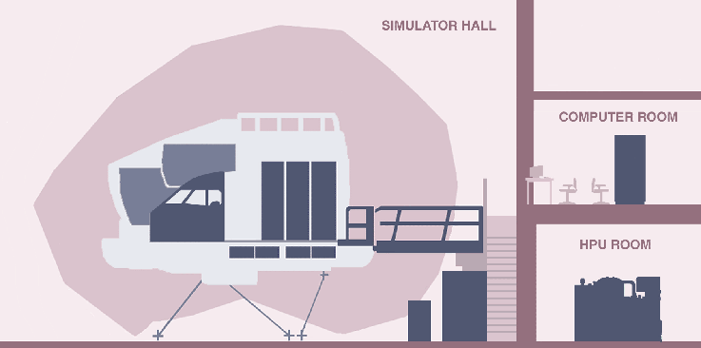
A320 Simulator Complex
Notes:
1 Overview Physical
9-Aug-99
Robbie Young Instructor Notes TTSL Prod Training Department

Slide 3
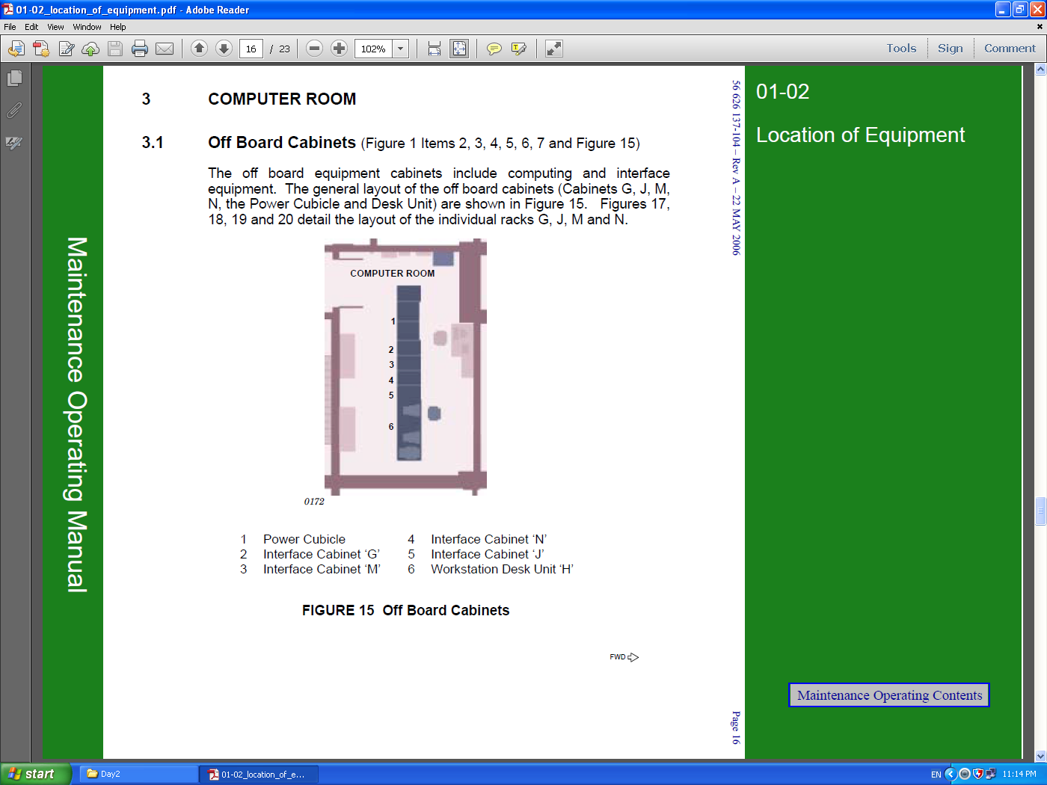

Slide 4
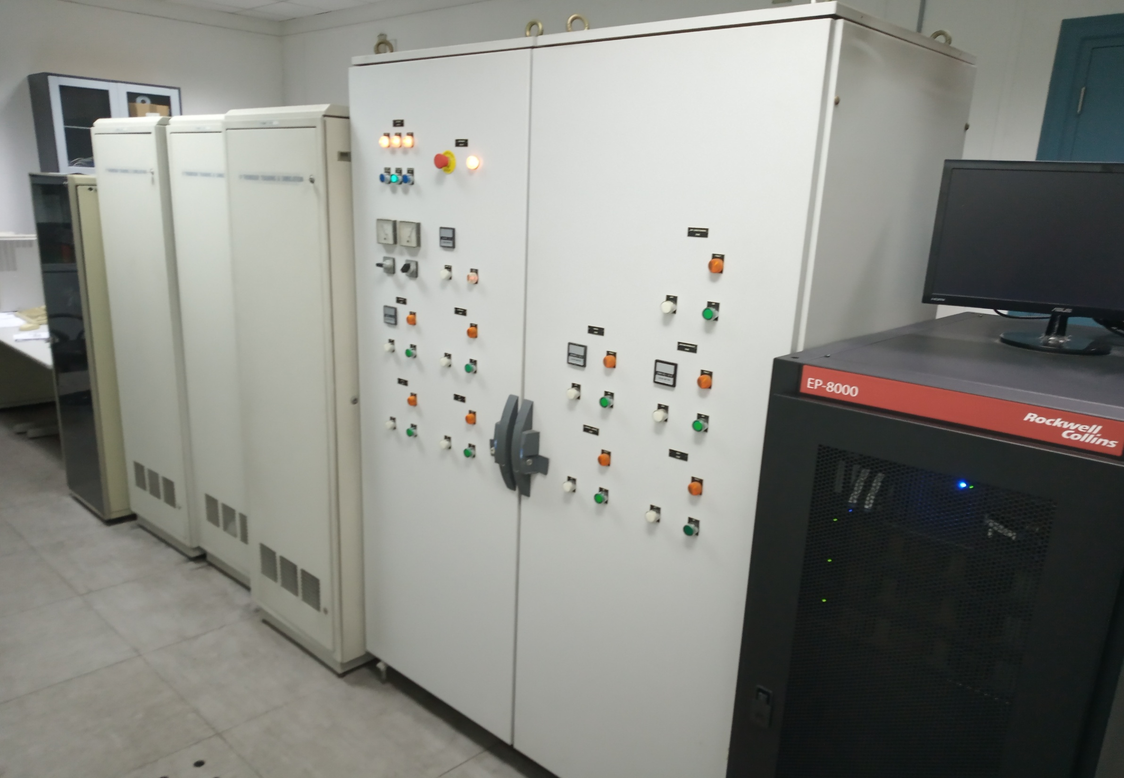

Slide 5
A320 Computer Room
J
N
M
G
AMPLIFIER
Power supply
Junction Box
Power supply
AKAI
Sampler
Static Inverter
Gg
PSU
PSU
PSU
Static Inverter
Gh
SEC1
ELAC1
&
ELAC2
Static Inverter
Gj
Ethernet Hub
Static Inverter
Gk
REPADIS
RS232
RS232
Static Inverter
Gl
REPADIS
HOT SPARE
HOST
Kontron
Jg
CDF
computer
HOST
Computer
400hz Relays
Gm
SEC2
SEC3
HOT SPARE
SSH
Kontron
Jg
IOS
Computer
Notes:
1 Overview Physical
9-Aug-99
Robbie Young Instructor Notes TTSL Prod Training Department

Slide 6
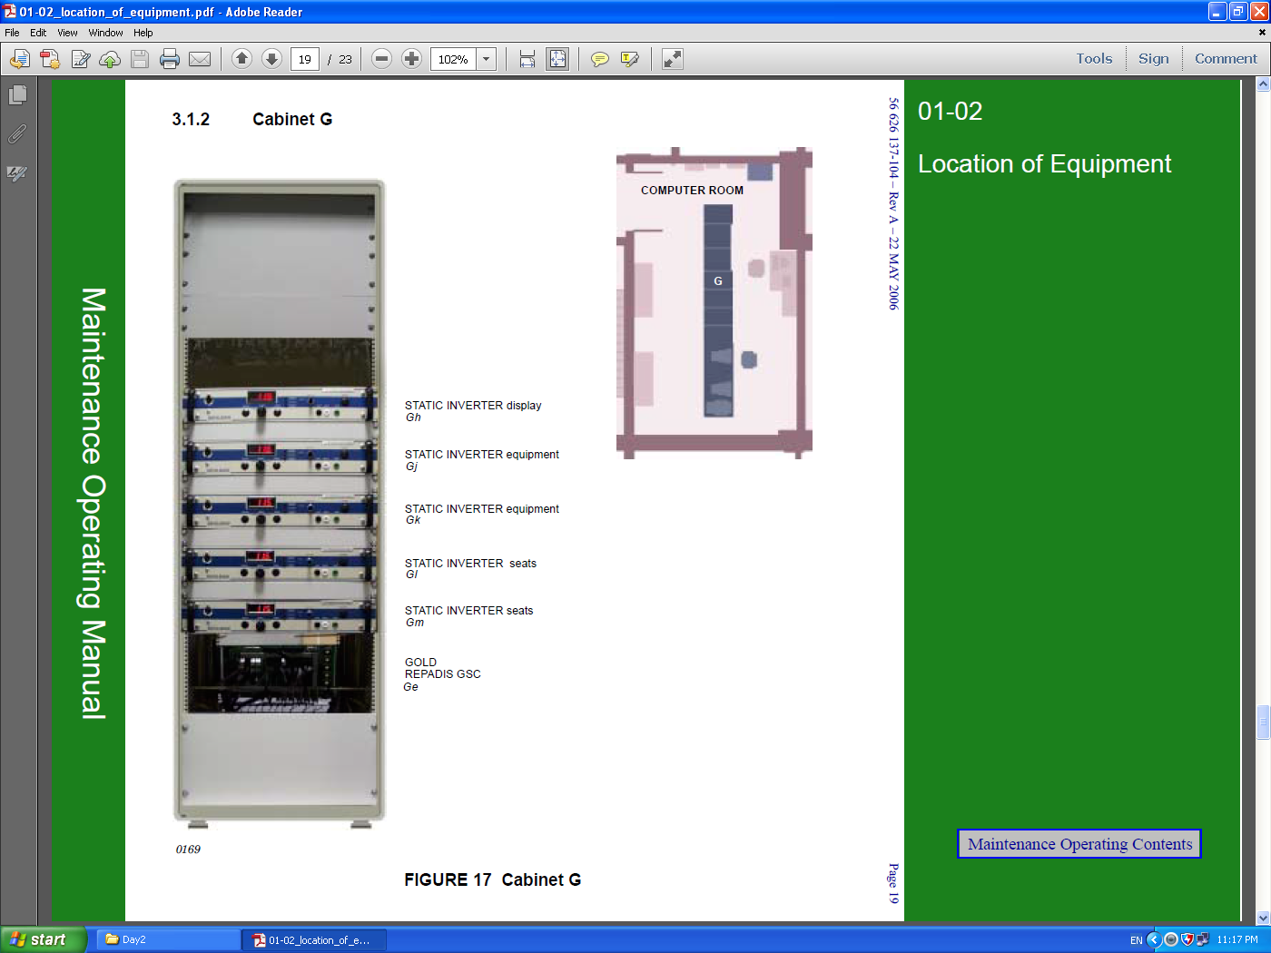

Slide 7
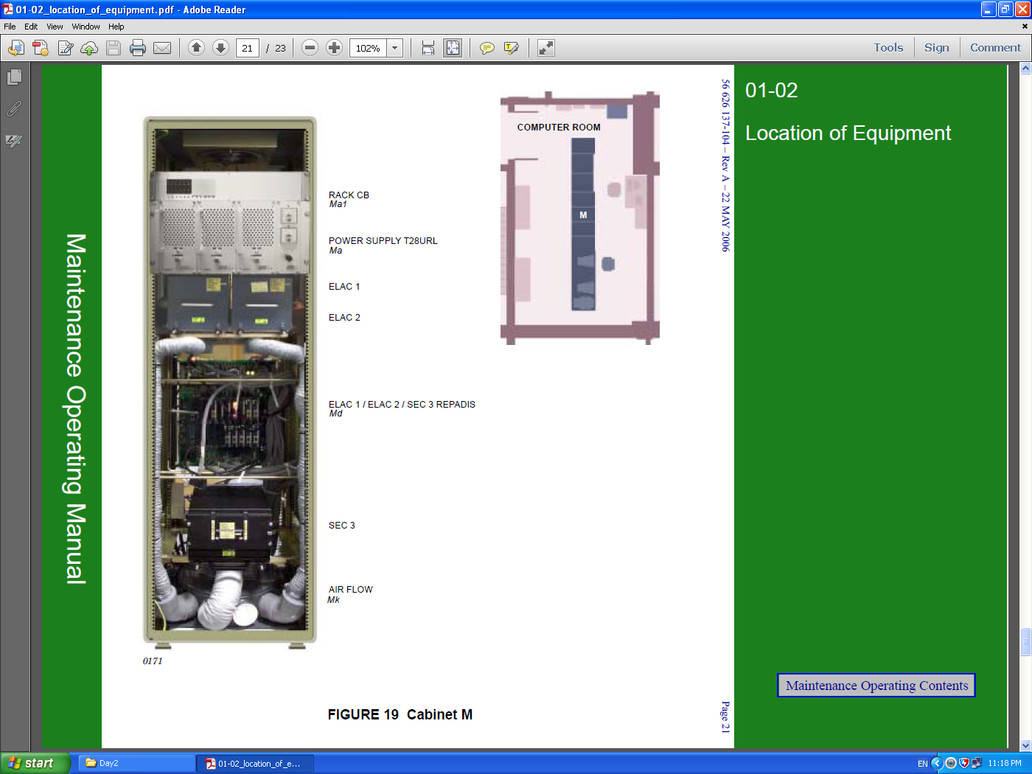

Slide 8
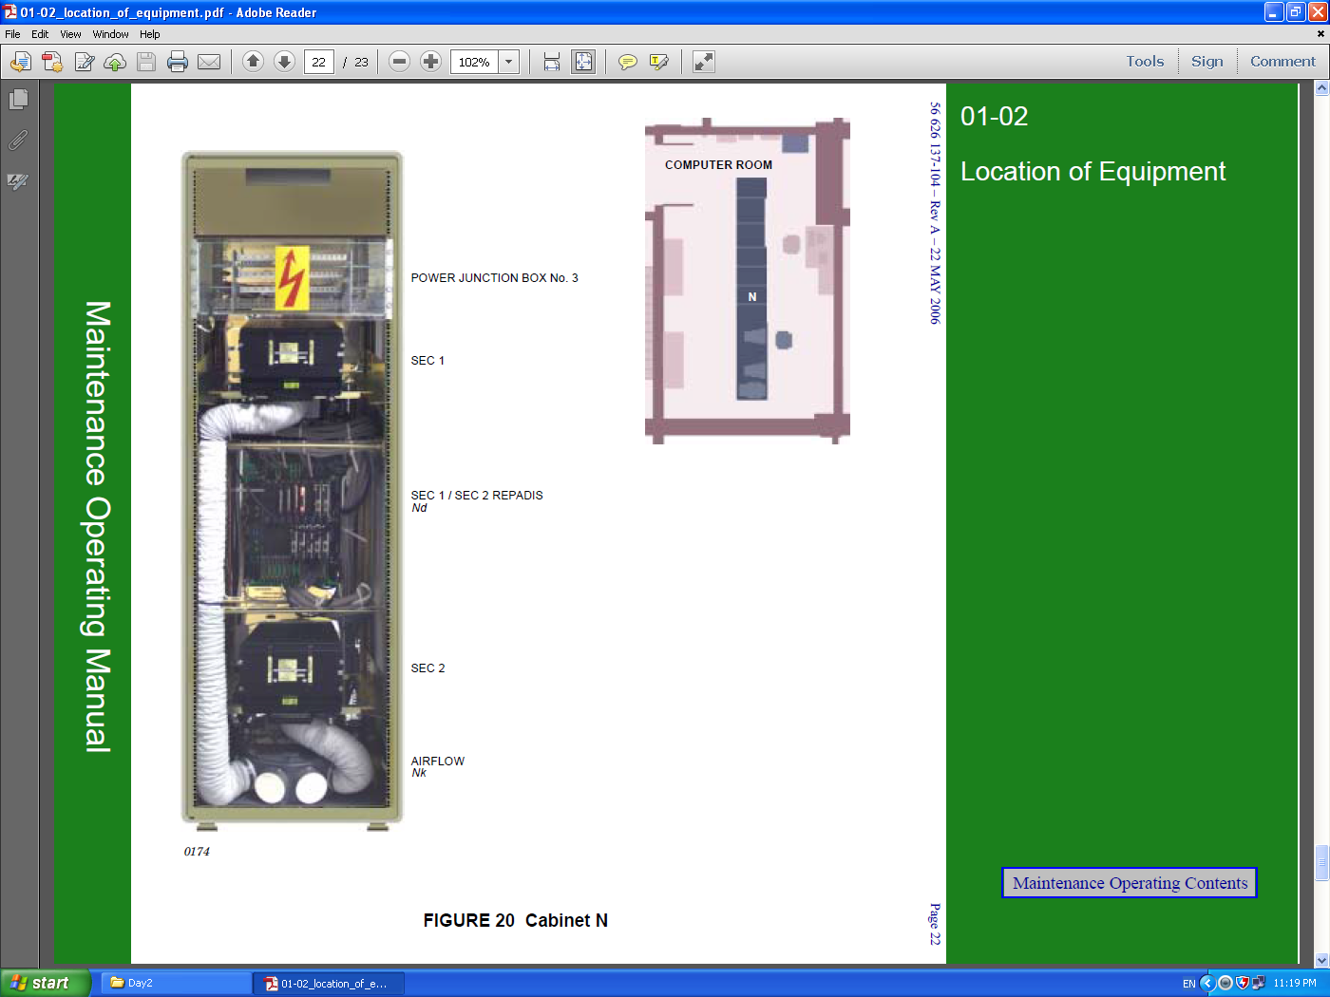

Slide 9
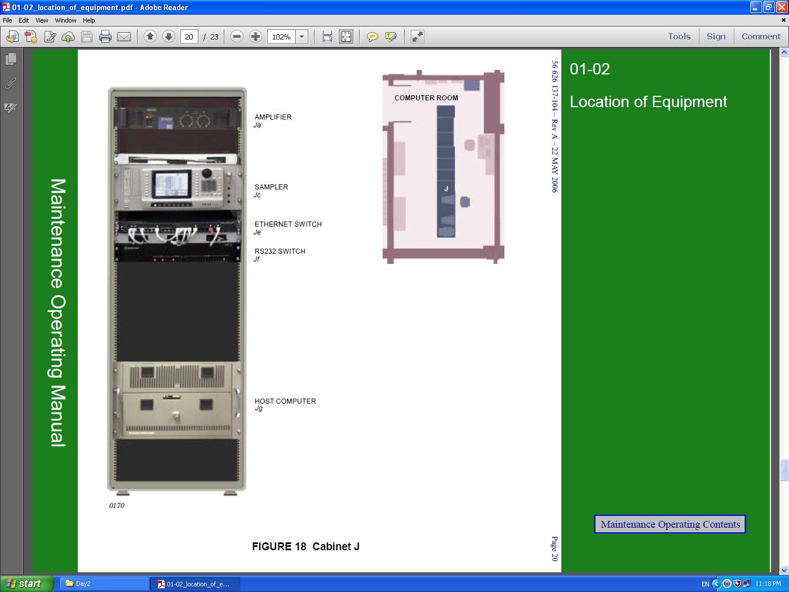

Slide 10
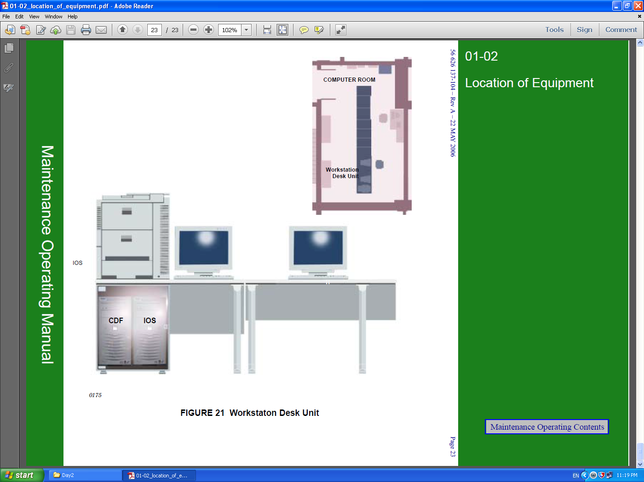

Slide 11


References : THALES STD simulator Manufacture manual .
?
Please Feel free to Ask
Practical

